Slide 1

Accuracy metrics or confusion metrics in Machine Learning
Presented by :-
Hrishikesh Deshpande
ads

Slide 2
What is confusion metrics ?
Basically, we use confusion metrics to find accuracy and complete performance and details of all our classification based model.
When we calculate confusion metrics it gives us 4 values.
It is much better way to enhance performance of classifier.
And it used to compare predicted and actual values.
These 4 values are tp, tn, fp, fn. ( true positive, true negative, false positive and false positive values )

Slide 3
What are true positive, true negative, false positive and false positive values ?
There are 2 types of main values :- Predicted and actual.
Predicted : values given by our model.
Actual : the actual target value.
E.g. if team is winning (+) or losing (-) the match.
According to predicted and actual values we can get 4 values that are tp, tn, fp, fn.

Slide 4
1. true positive (tp) : Actual positive and predicted as positive. Here p is model predicted positive value. According to basis of categorizing with actual values we get this.
e.g. team has won the match and is told that they won it.
1. true negative (tn) : Actual negative and predicted as negative. Here p is model predicted negative value.
e.g. team has lost the match and is told that they lost it.

Slide 5
TYPE 1 AND TYPE 2 ERROR :
3. false positive (fp) : Actual negative but predicted as positive. Here p is model predicted positive value.
Also called as type 1 error.
e.g. team has lost the match but is told that they won it.
4. false negative (fn) : Actual positive but predicted as negative. Here p is model predicted negative value.
Also called as type 2 error.
e.g. team has won the match but is told that they lost it.
A good model can be considered as with high tp and tn rates while, low fp and fn rates.

Slide 6
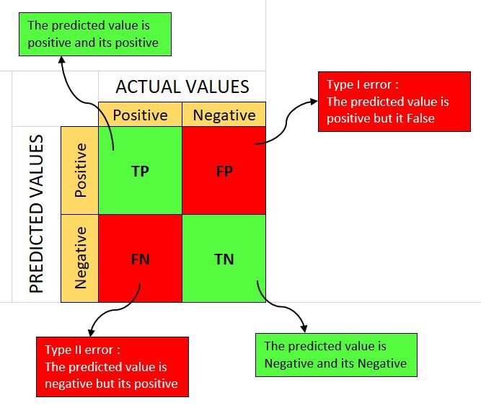

Slide 7
What is accuracy and error rate ?
Accuracy : it is nothing but how many true values we are getting out of the total. From all classes how many we have predicted correctly.
It should be high as possible.
accuracy = (tp + tn) / total
Error rate : this is value of errors of false values we are getting and it is vise versa of accuracy.
error rate = (fp + fn) / total or 1 – accuracy

Slide 8
What is precision and recall ? Precision (positive predicted value) recall (Sensitivity, hit rate, true positive rate )
Precision : here, we are calculating total true / positive values from predicted yes values.
Precision should be high as possible.
Ppv = tp / predicted yes
= Ppv = tp / (tp + fp)
Recall : here, from actual positive classes we are finding how many we are predicted correctly.
Recall also should be high as possible.
Tpr = tp / actual yes
= tpr = tp / (tp + fn)

Slide 9
What is f1 score in accuracy metrics ?
We can say if our model has high precision and recall both, our model will be good.
Or if it has low precision or recall then model won’t be good or cannot predicted well.
But, what if we have low precision and high recall or vice versa, so to make them comparable we use f1 score.
It helps to measure recall and precision at the same time. It uses here harmonic mean instead of arithmetic mean.
It gives us result by comparing both precision and recall.

Slide 10
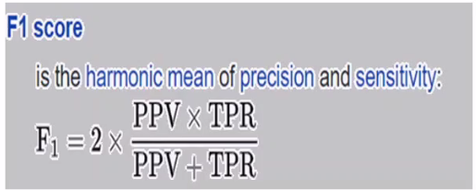
F1 score is harmonic mean of precision and recall, and so it gives combined idea of these two metrics.
Closer the f1 score to the 1, better the accuracy of our model.
F1 = 2 * recall * precision / Recall + precision

Slide 11
Thank you !!

